Slide 1
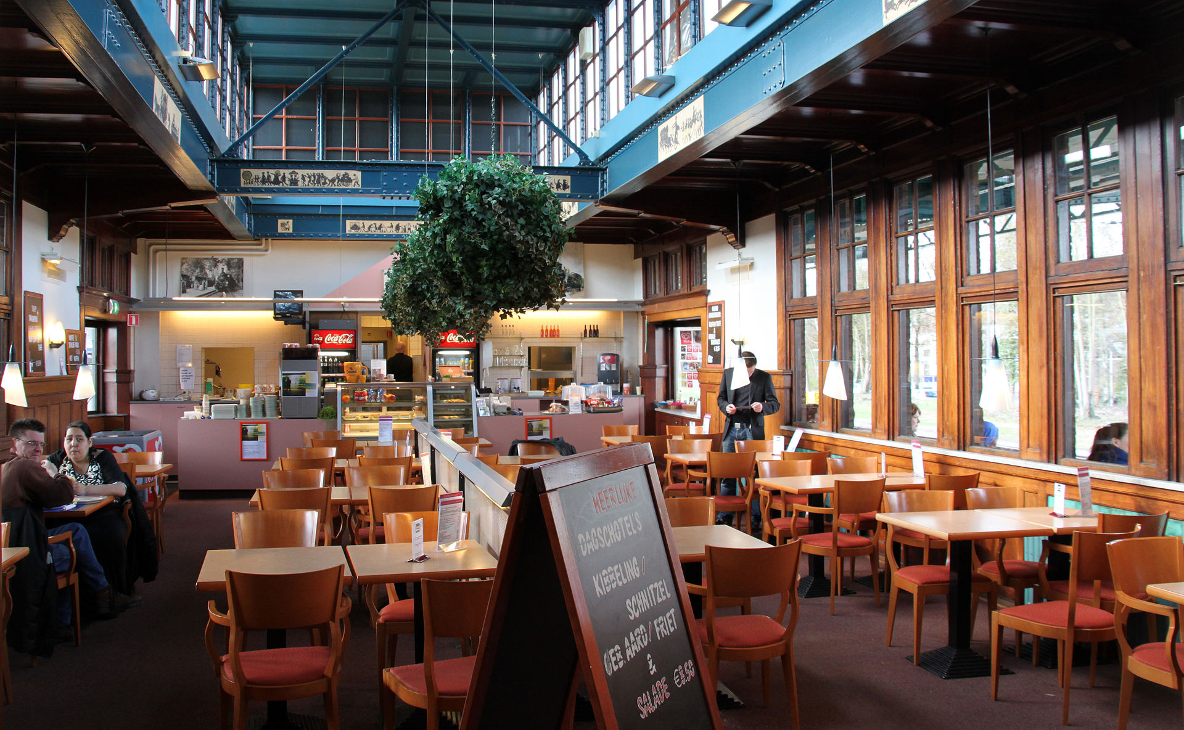
Restaurant Recommender System
Coursera Capstone Project

Slide 2
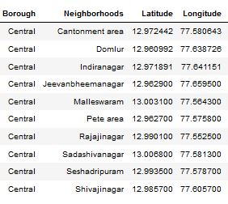
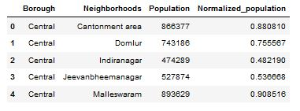
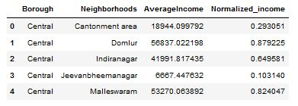

Data Collection & Requirements

Slide 3
Methodology
Recommender System
Machine Learning
Data Exploratory Analysis
Inferential Analysis

Slide 4
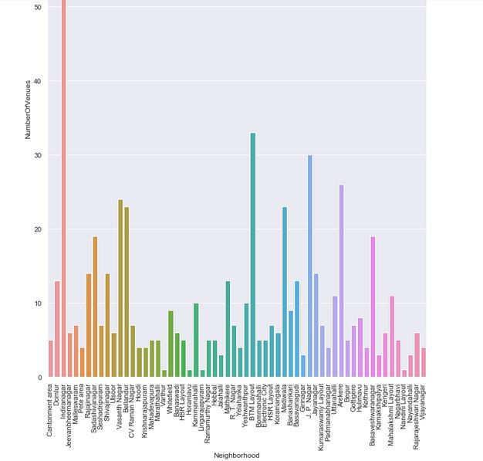
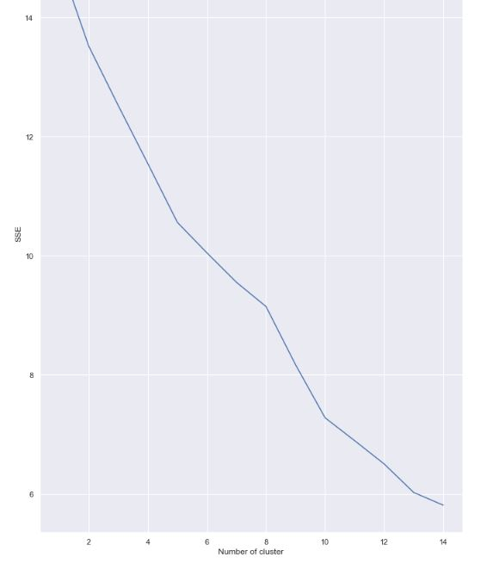
Methodology

Slide 5
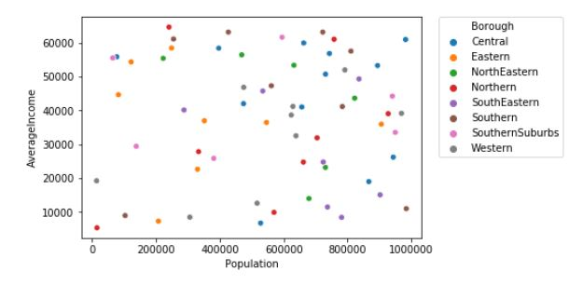
Methodology

Slide 6
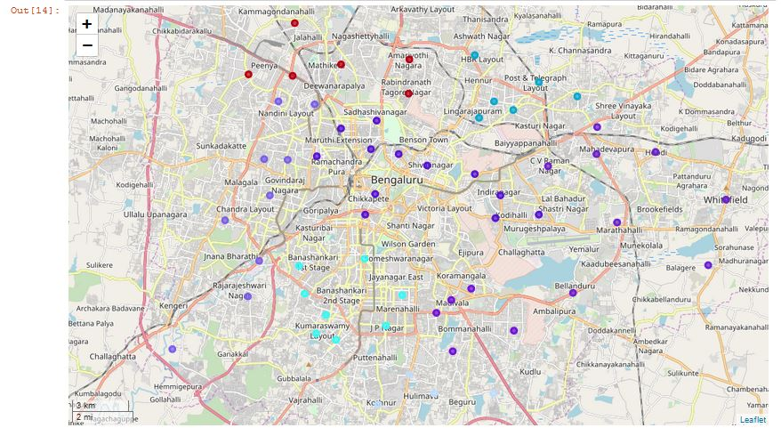
Mapping & Clustering

Slide 7
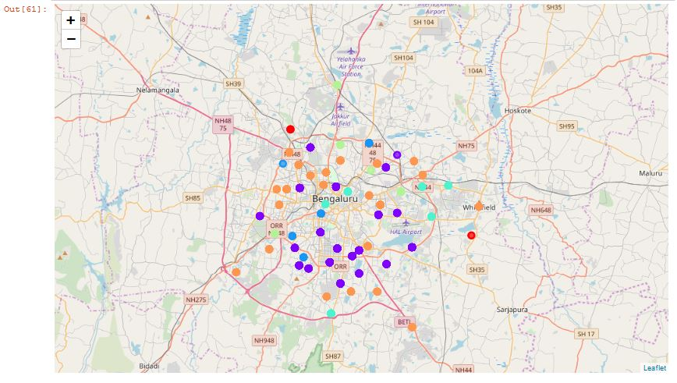
Mapping & Clustering

Slide 8
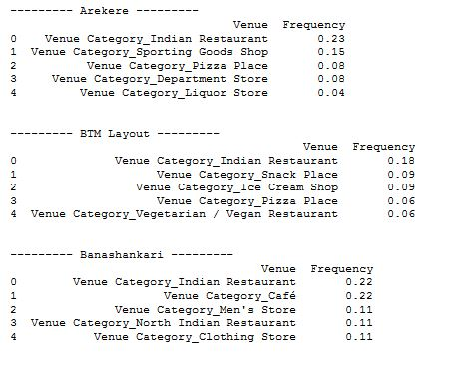

Results

Slide 9
Thank You!

